Slide 1
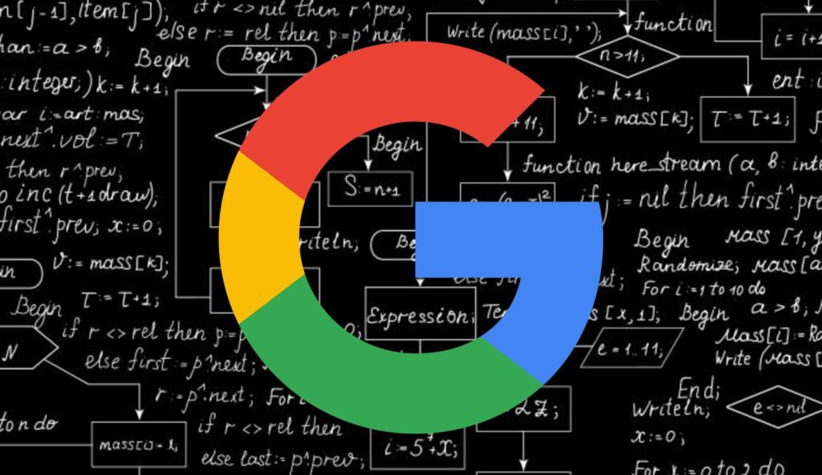
Page Rank Algorithm
TEAM 10
Page Rank Algorithm Page Rank Algorithm Page Rank Algorithm
Mathematics for Computing 1

Slide 2
Table of Contents
Introduction | What is Google Page Rank Algorithm ?
Methodology | Methodology of finding the Rank
Calculations | Try with an example
Code | MATLAB and JavaScript Codes
Conclusion | Concluding the Topic

Slide 3
Team 10 Batch B
B Preetam Teja – CB.EN.U4AIE22112
Vishal S – CB.EN.U4AIE22157
Modi Dharma Theja Yadav – CB.EN.U4AIE22137
Nandana Gireesh – CB.EN.U4AIE22138
Google Page Rank Algorithm Google Page Rank Algorithm

Slide 4
01
Introduction
What is Page Rank Algorithm ?

Slide 5
Page Rank Algorithm
The PageRank algorithm outputs a probability distribution used to represent the likelihood that a person randomly clicking on links will arrive at any particular page. PageRank can be calculated for collections of documents of any size.
The basis of the Google search engine is the Page Rank algorithm. It was created in 1996 while Larry Page and Sergey Brin were doctoral candidates at Stanford University.
To rank websites in the search results and identify their relevance and importance, the algorithm employs a complex mathematical formula.
The Page Rank algorithm is an essential component of the Google search engine, providing users with accurate and relevant search results
Page Rank Algorithm Page Rank Algorithm Page Rank Algorithm

Slide 6
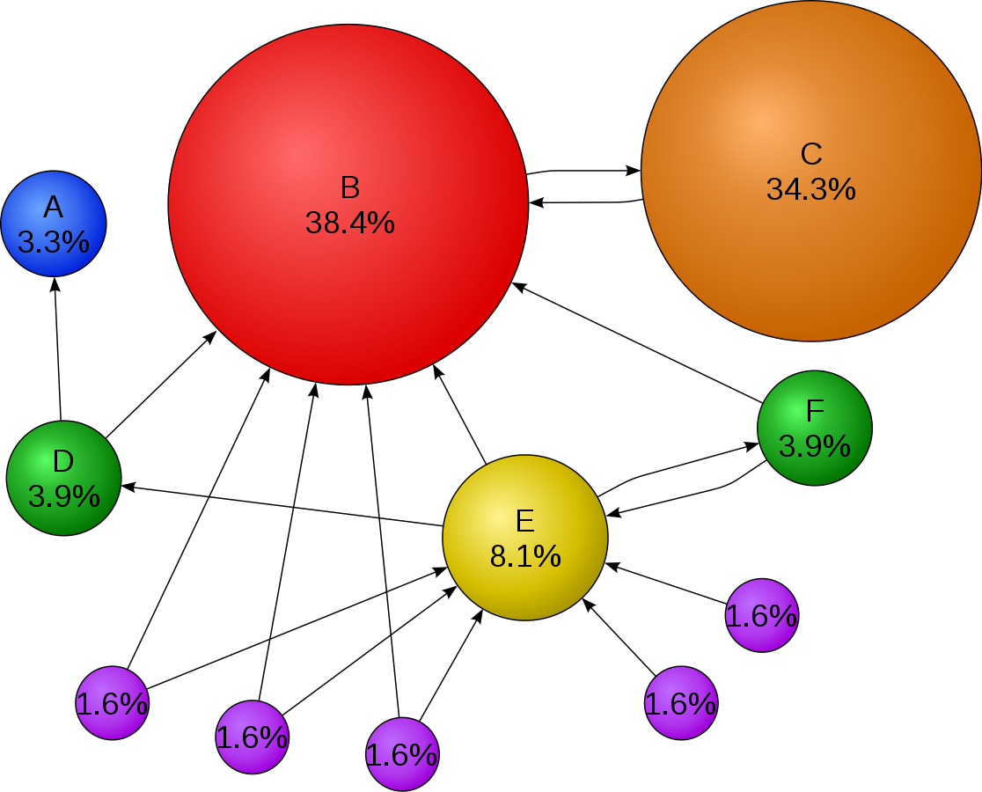
Page Rank Algorithm
The algorithm's impact on the field of search engine optimization has also been significant, with website owners working to improve their website's Page Rank score to rank higher in the search results.

Slide 7
02
Methodology
Methodology of Finding the Rank

Slide 8
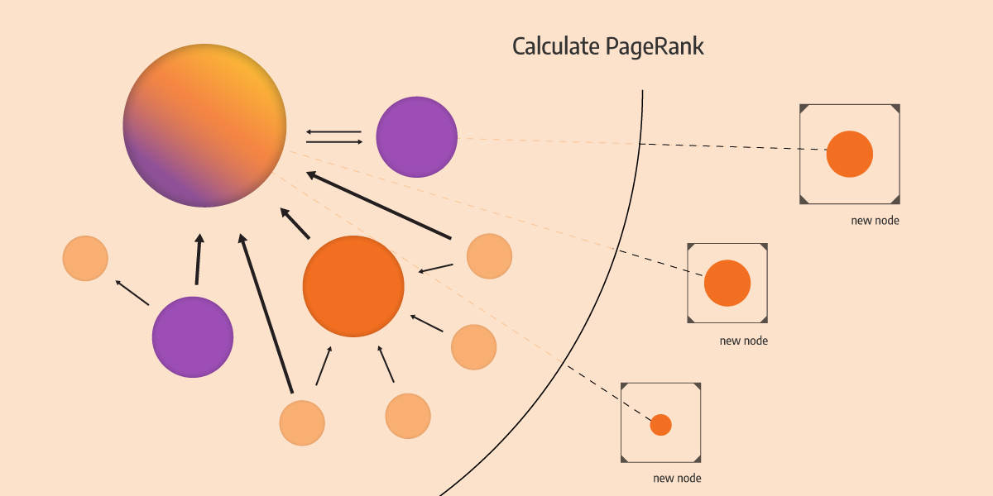
Page Rank Algorithm - Methodology
The PageRank algorithm uses a recursive formula to calculate the importance of each web page.
The basic idea is that a web page is important if many other web pages link to it, and the importance of these linking pages is also taken into account.
The algorithm works by assigning a score of 1 to each page and then repeatedly updating the scores based on the links between pages.
The process continues until the scores no longer change, at which point a final score is assigned to each page

Slide 9
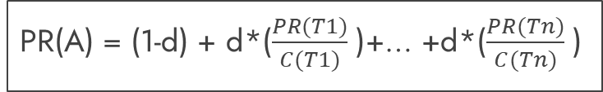
Page Rank Algorithm
PR(A) = (1-d) + d*($\frac{PR(T1)}{C(T1)}$ )+… +d*($\frac{PR(Tn)}{C(Tn)}$ )
Where,
PR(A) is the PageRank of page A
d is a damping factor, typically set to 0.85
PR(Ti) is the PageRank of pages linking to page A
C(Ti) is the number of outgoing links from page T
Where,
PR(A) is the PageRank of page A
d is a damping factor, typically set to 0.85
PR(Ti) is the PageRank of pages linking to page A
C(Ti) is the number of outgoing links from page T

Slide 10
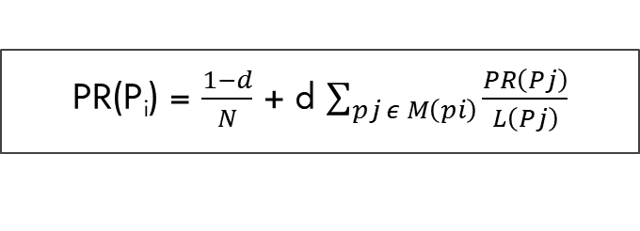
Page Rank Algorithm
PR(P_{i}) = $\frac{1−d}{N}$ + d $\sum_{pj ε M\left(pi\right)}{\frac{PR\left(Pj\right)}{L\left(Pj\right)}}$
Where,
p1, p2, p3,…, pn are the pages
M(pi) is the set of pages that links to pi
L(pi) is the number of outgoing links on the page pi
N is the total number of pages

Slide 11
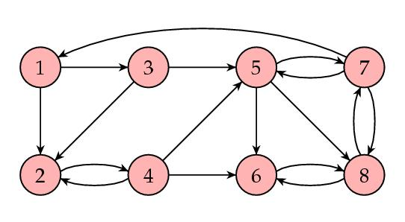
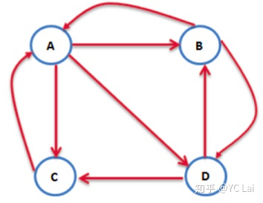
Page Rank Algorithm
Damping Factor
The damping factor, d, is used to reduce the influence of random jumps, or “teleporting,” between pages.
The damping factor is typically set to 0.85, which represents a tradeoffs between following links and reducing the influence of random jumps.
The damping factor of 0.85 means that there is a 15% chance that a user will randomly stop clicking links and start a new search or visit a new website.
In other words, it is used to ensure that the algorithm does not get stuck in an endless loop of following links from one page to another.
The damping factor is important because there is no condition that webpages on the internet should be linked to one another.

Slide 12
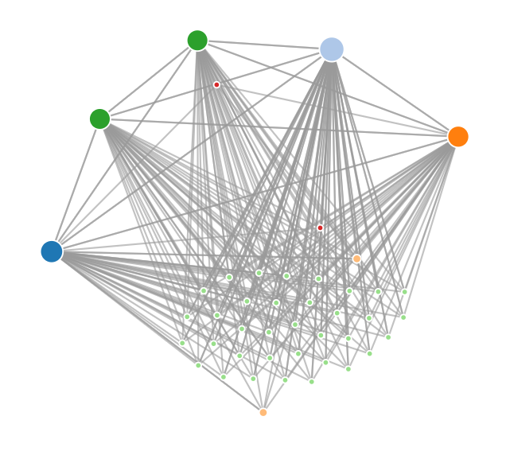
Page Rank Algorithm

Slide 13
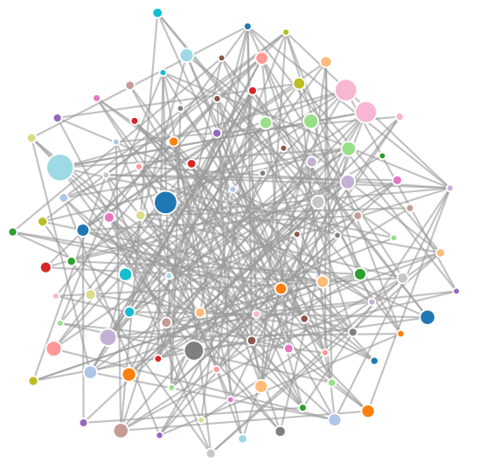
Page Rank Algorithm

Slide 14
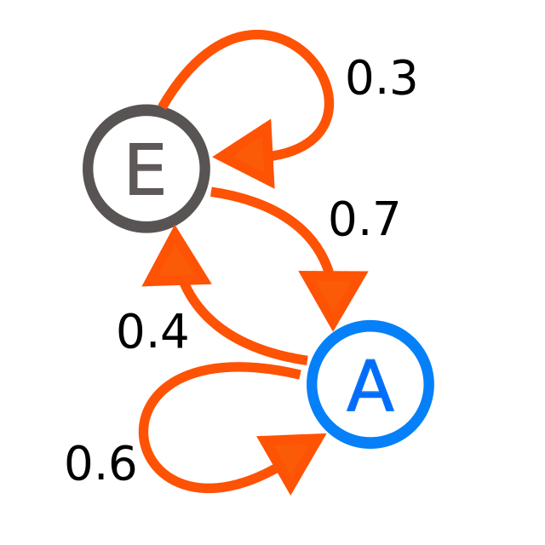
Markov’s Chain
Markov Chain is a mathematical model that describes a sequence of events where each event is dependent only on the previous event.
In other words, it's a probabilistic model that defines a sequence of states where the probability of moving from one state to another depends only on the current state.
The PageRank of a web page can be calculated as the steady-state probability distribution of the Markov Chain.

Slide 15
03
Calculations
Try with an example

Slide 16
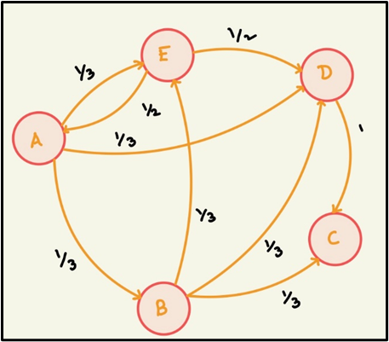
Calculations
Assume there are only 5 pages on the Internet (A, B, C, D, E), •
Page A links to E, B, D •
Page B links to C, D, E •
Page C doesn't link to any page •
Page D links to C •
Page E links to A, D

Slide 17
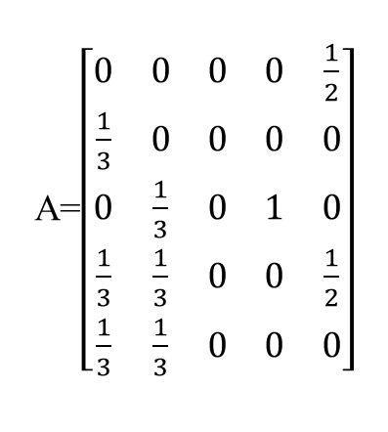
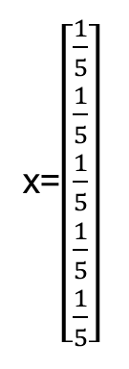
Calculations
A=$\left[\begin{matrix}0 & 0 & 0 & 0 & \frac{1}{2} \\ \frac{1}{3} & 0 & 0 & 0 & 0 \\ 0 & \frac{1}{3} & 0 & 1 & 0 \\ \frac{1}{3} & \frac{1}{3} & 0 & 0 & \frac{1}{2} \\ \frac{1}{3} & \frac{1}{3} & 0 & 0 & 0\end{matrix}\right]$
x=$\left[\begin{matrix}\frac{1}{5} \\ \frac{1}{5} \\ \frac{1}{5} \\ \frac{1}{5} \\ \frac{1}{5}\end{matrix}\right]$
If the iterations continue for n times, the matrix converges to same value.
Therefore,
xn+1=A*xn
This Equation is of the form,
A.x= λ.x
Importance vector x is an eigenvector of A with eigenvalue 1

Slide 18
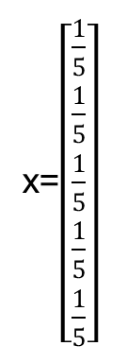
Calculations
A=$\left[\begin{matrix}0 & 0 & 0 & 0 & \frac{1}{2} \\ \frac{1}{3} & 0 & 0 & 0 & 0 \\ 0 & \frac{1}{3} & 0 & 1 & 0 \\ \frac{1}{3} & \frac{1}{3} & 0 & 0 & \frac{1}{2} \\ \frac{1}{3} & \frac{1}{3} & 0 & 0 & 0\end{matrix}\right]$
x=$\left[\begin{matrix}\frac{1}{5} \\ \frac{1}{5} \\ \frac{1}{5} \\ \frac{1}{5} \\ \frac{1}{5}\end{matrix}\right]$
x=Ax
x=A²x
x=A³x
.
.
.
x=A^{n}x

Slide 19
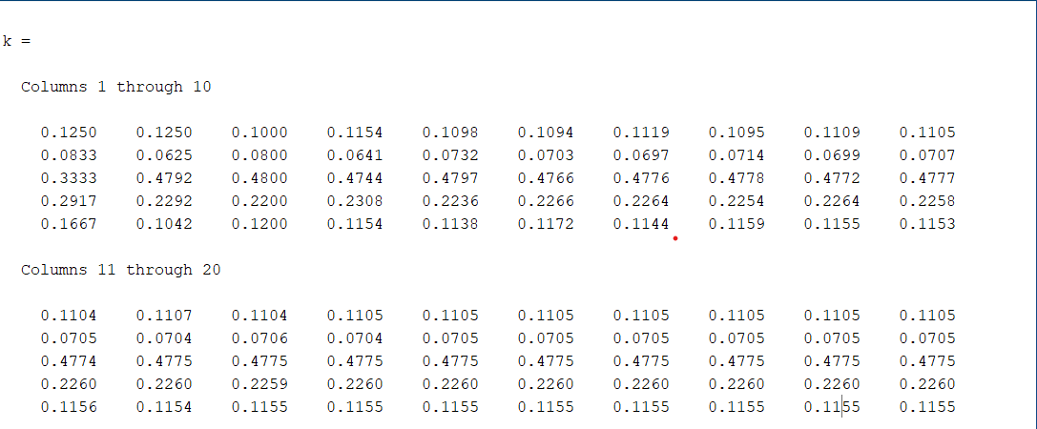
Calculations
Without Considering Damping Factor

Slide 20
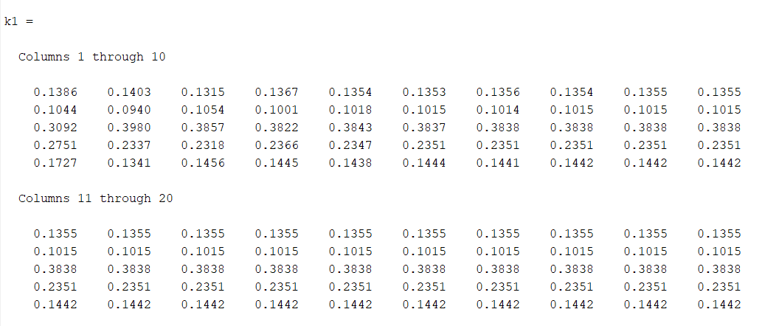
Calculations
Considering Damping Factor

Slide 21
04
Code
MatLab and Javascript Codes

Slide 22
MatLab
% Considering Equal probability for landing in Pages Initially
x=[1/5 1/5 1/5 1/5 1/5]';
% Concatnating Each iteration into a Matrix for our understanding
k=[];
for i=1:20
x=A*x;
k=[k x];
end
k
x=x/sum(x);
rank1=rankMatrix(x);
%% Page Rank Algorithm
% Without considering Damping Factor
% Page A links to E, B, D
% Page B links to C, D, E
% Page C doesn't link to any page
% Page D links to C
% Page E links to A, D
A1=[0 1/3 0 1/3 1/3;
0 0 1/3 1/3 1/3;
0 0 0 0 0;
0 0 1 0 0;
1/2 0 0 1/2 0];
A=A1’;

Slide 23
MatLab
% Considering Damping Factor
x1=[1/5 1/5 1/5 1/5 1/5]';
% Damping Factor is set to 0.85
d=0.85;
% Concatenating Each iteration into
k1=[];
for i=1:20
x1=d*(A*x1)+((1-d)/5);
k1=[k1 x1];
end
K1;x1=x1/sum(x1);
rank2=rankMatrix(x1);

Slide 24
MatLab
function rankedMatrix = rankMatrix(matrix)
[m, n] = size(matrix); % Get the number of rows and columns in the matrix
rankedMatrix = zeros(m, n); % Initialize a matrix to store the ranks
for j = 1:n % Loop through each column of the matrix
column = matrix(:, j); % Get the current column of the matrix
% Sort the current column in ascending order
[sortedColumn, index] = sort(column);
for i = 1:m % Loop through the sorted column and assign ranks
rankedMatrix(index(i), j) = m-i+1;
end
end
end

Slide 25
MatLab
function [x] = page_rank(G,x,damping, iterations)
% Initialize PageRank vector
n = size(G, 1);
% Loop until change in PageRank is below the tolerance
for i = 1:iterations
% Calculate new PageRank
x = ((1 - damping) / n) + damping *(G*x);
x=x/sum(x);
end
x = x/sum(x);
end

Slide 26
JavaScript
// Page Rank Algorithm
// Define the link matrix as a 2D array
var linkMatrix = [ [0, 1, 1, 0, 0],
[1, 0, 1, 1, 0],
[0, 0, 0, 1, 1],
[1, 1, 1, 0, 1],
[1, 1, 0, 1, 0]];
var numPages = linkMatrix.length; // Define the number of pages
var dampingFactor = 0.85;
var pageRank = []; // Define the PageRank vector
// Initialize the PageRank vector to a uniform distribution
for (var i = 0; i < numPages; i++) {
pageRank[i] = 1 / numPages;
}

Slide 27
JavaScript
// Iterate the PageRank algorithm until convergence
var convergence = false;
while (!convergence) {
// Store the previous PageRank vector
var previousPageRank = pageRank.slice();
// Update the PageRank vector
for (var i = 0; i < numPages; i++) {
pageRank[i] = (1 - dampingFactor) / numPages;
for (var j = 0; j < numPages; j++) {
if (linkMatrix[j][i] === 1) {
pageRank[i] += dampingFactor * previousPageRank[j] /
numLinks(linkMatrix[j]);}
}
}

Slide 28
JavaScript
// Check for convergence
convergence = isConverged(previousPageRank, pageRank);
}
// Print the PageRank vector
console.log("Page Rank Algorithm");
console.log("Matrix A : ");
console.log(linkMatrix);
console.log("Probabilities :");
console.log(pageRank);
// Printing the Rank of the Pages using PageRank vector
console.log("Rank :")
console.log(rankArray(pageRank));

Slide 29
JavaScript
for (var i = 0; i < previous.length; i++) {
if (Math.abs(previous[i] - current[i]) > threshold) {
return false;
}
}
return true;
}
function rankArray(arr) {
let sortedArr = [...arr].sort((a, b) => b-a);
let ranks = arr.map(val => sortedArr.indexOf(val) + 1);
return ranks;
}
// Function to count the number of outgoing links from a page
function numLinks(page) {
var count = 0;
for (var i = 0; i < page.length; i++) {
count += page[i];
}
return count;
}
// Function to check for convergence of the PageRank vector
function isConverged(previous, current) {
var threshold = 0.0001;

Slide 30
05
Conclusion
Concluding the Presentation

Slide 31
Conclusion
A key element of how the internet works is the Page Rank algorithm. It is a technique created by the co-founders of Google, Larry Page and Sergey Brin, to assess the significance and relevance of a webpage based on the quantity and caliber of links going to it. The Page Rank algorithm, which still serves as the foundation of Google's search engine, has had a big impact on how data is found and displayed online. Because of its widespread impact, search engine optimization and website rankings are now synonymous with this term. The Page Rank algorithm, with its ongoing development and advancement, continues to be a crucial tool for navigating the internet's immense ocean of information.

Slide 32
Thank You!

